Slide 1
Basics Of REACT:
JSX (JavaScript XML)
Components
Props (Properties)
State
Data Flow
Hooks
Virtual DOM

Slide 2
JSX (JavaScript XML)
HTML inside JavaScript.
JavaScript inside HTML.
React look like HTML but behave like JavaScript

Slide 3
Components
A component is a reusable piece of UI.
one component can contain others.

Slide 4
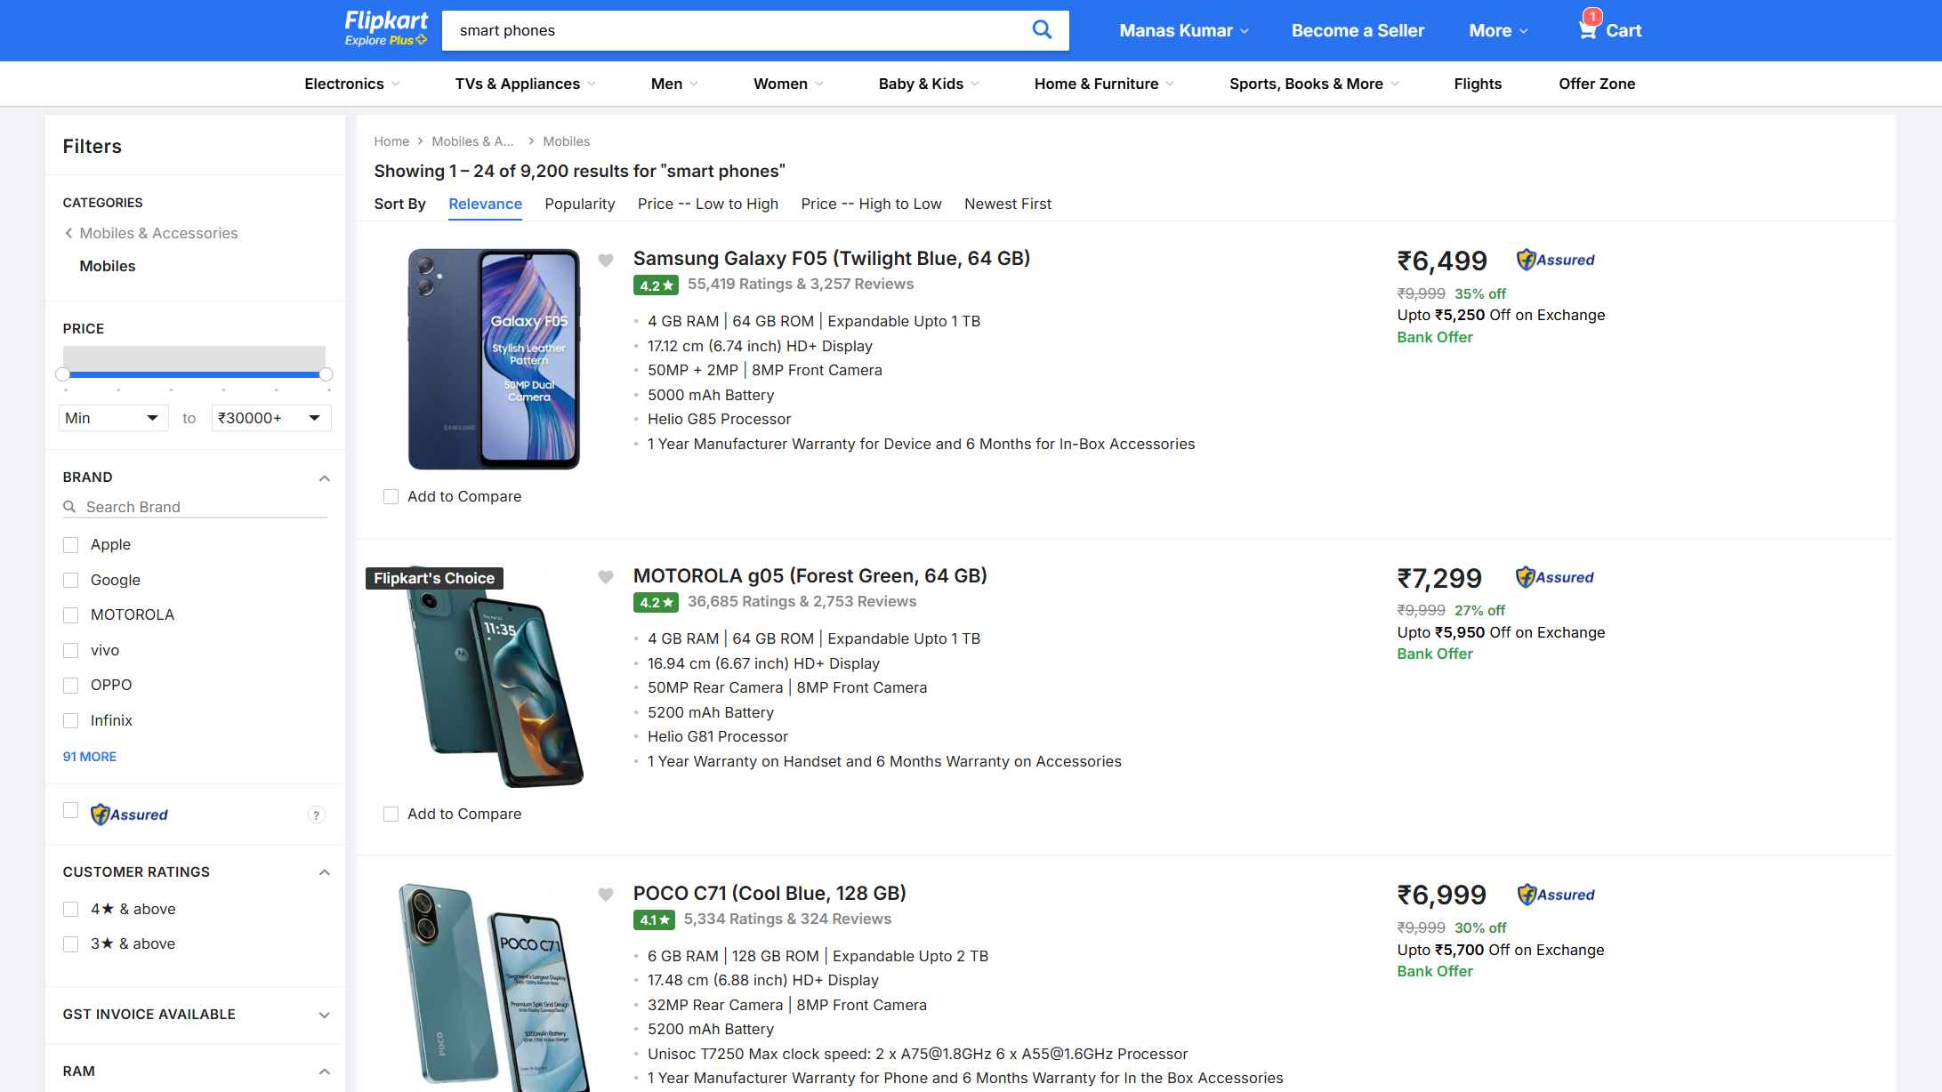

Slide 5
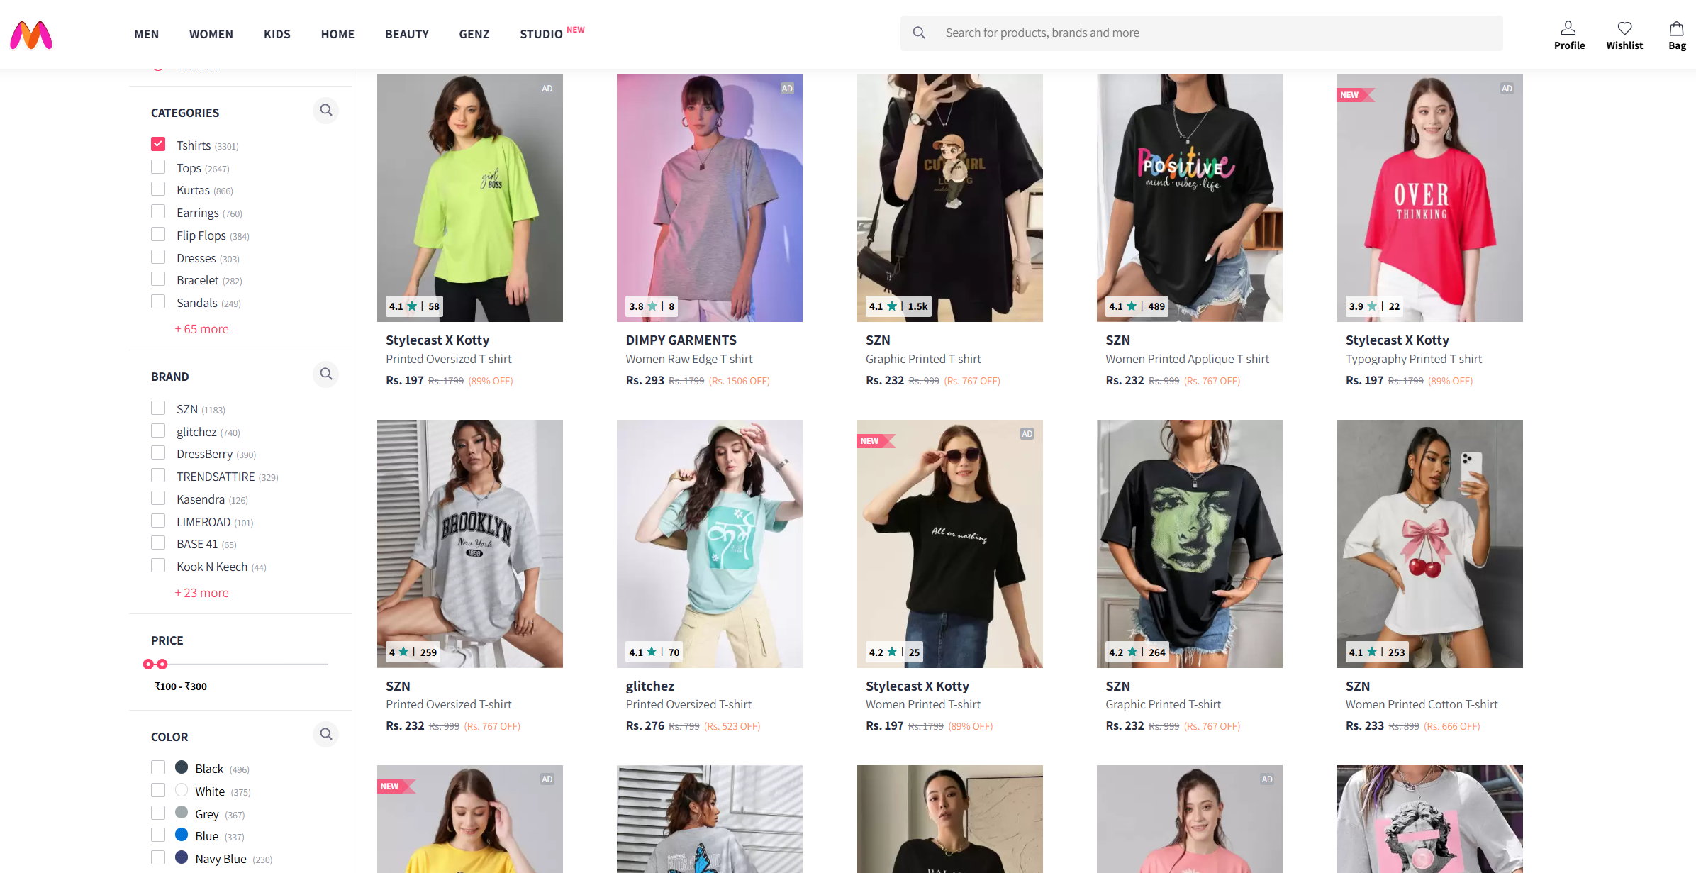

Slide 6
Props
Props = “properties”
Used for send data to a component.
Read Only
Similar to function parameter

Slide 7
State
State = local data for a component
Changing state updates UI, React will React.

Slide 8
Data Flow
React uses one-way data flow.
Data flows from parent to child via props.
State is local to a component

Slide 9
Hooks
Hooks let you use state, lifecycle, refs, and context in function components
Only call hooks inside React functions

Slide 10
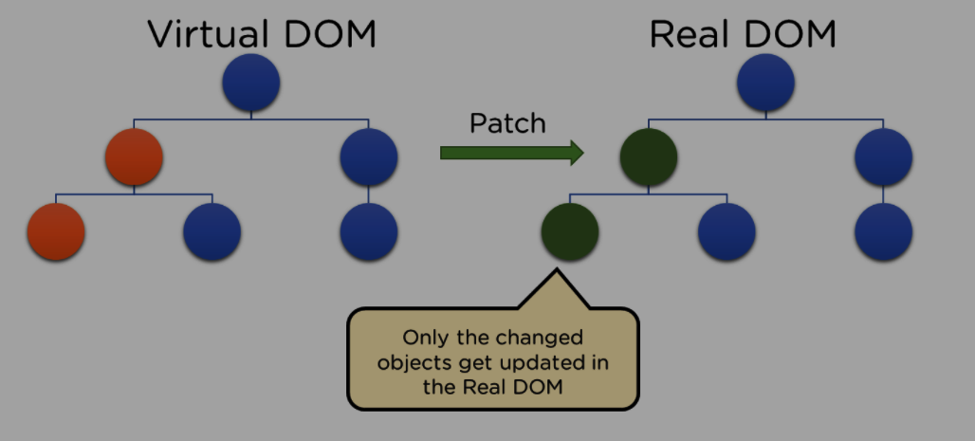
Working Of React Js

Slide 11
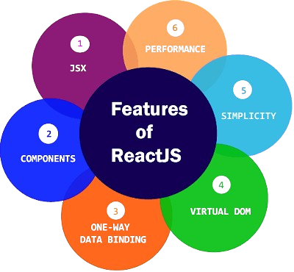
Features Of React Js

Slide 12
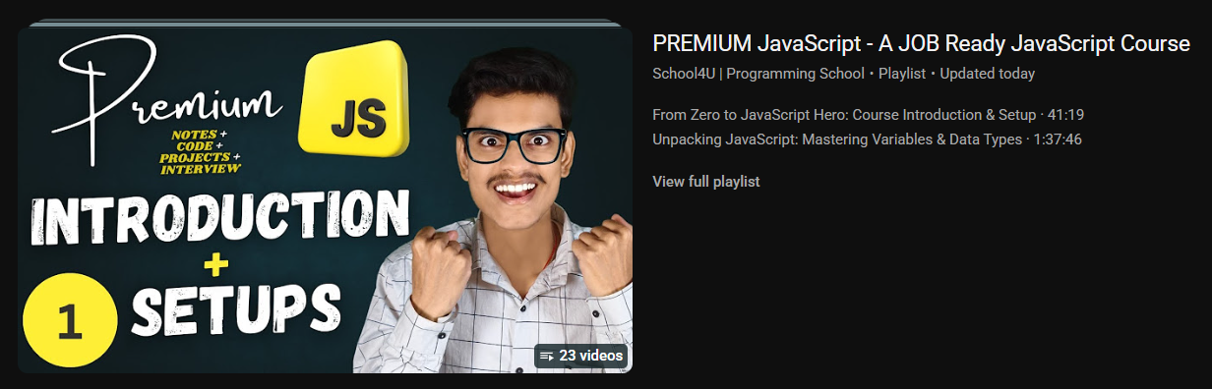
You Should Go For React
Only After
Mastering JavaScript

